Slide 1
Case Study Title
CRM CASE STUDY

Slide 2
Name
Personal Info
Etc.

Slide 3
Question Policy

Slide 4
Overview
Objectives
Critical Skills Review
Case Study Focus Skill
Synopsis
Focus Questions

Slide 5
Objectives
Terminal Objective
Enabling Objective

Slide 6
Crew Resource Management
Allows crew to interact effectively while performing mission tasks
A program to effect behavior modifications in order to prevent human factor and crew preventable errors
To improve mission effectiveness through increased awareness of associated behavioral skills
What does CRM mean to me?

Slide 7
CRM Critical Skills Review
Decision Making (DM)
Assertiveness (AS)
Mission Analysis (MA)
Communication (CM)
Leadership (LD)
Adaptability/Flexibility (AF)
Situational Awareness (SA)

Slide 8
Effective DM includes
Identifying the problem
Assessing time and risk constraints
Identifying possible solutions
Make a decision
Select and implement a course of action
Get feedback and reassess the problem

Slide 9
Factors which promote good Decision Making
More resources
Fewer time and risk constraints
Decision making strategies and experience level
The other critical skills

Slide 10
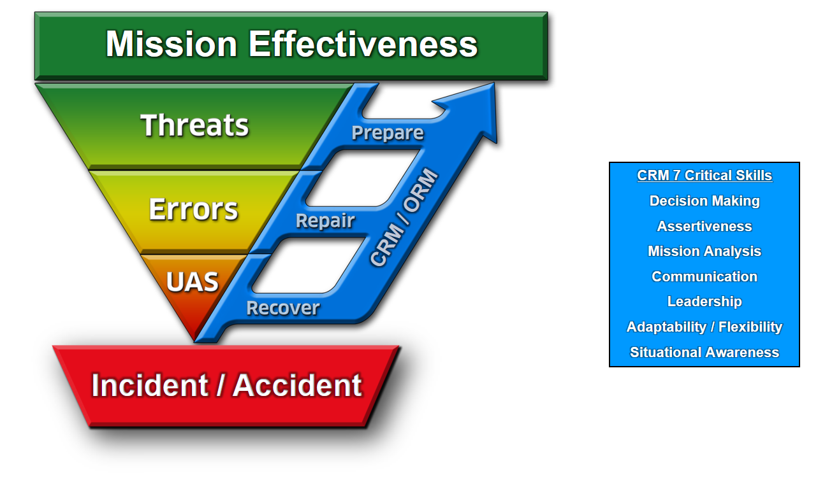
Threat and Error Management
TEM is what we do. CRM is how we do it.
Notes:
MASTER TEM SLIDE

Slide 11
Why Threat & Error Management?
In the past: We focused on eliminating human error in aviation.
Contemporary acknowledgement: Errors are inevitable, so…
We must instead focus on ways to effectively MANAGE and REDUCE errors

Slide 12
Mission Effectiveness
MISSION EFFECTIVENESS

Slide 13
Mission Effectiveness
MISSION EFFECTIVENESS
What is a mission?

Slide 14
Mission Effectiveness
MISSION EFFECTIVENESS
A Mission is the Task + Purpose

Slide 15
Mission Effectiveness
MISSION EFFECTIVENESS
How is Effectiveness defined?

Slide 16
Mission Effectiveness
MISSION EFFECTIVENESS
How is Effectiveness defined?
Completing the task to specific standards:
Time / Cost / Quality

Slide 17
Mission Effectiveness
MISSION EFFECTIVENESS
Mission Effectiveness is completing the task to specific standards in order to fulfill the purpose.

Slide 18
Mission
MISSION EFFECTIVENESS
Task + Purpose

Slide 19
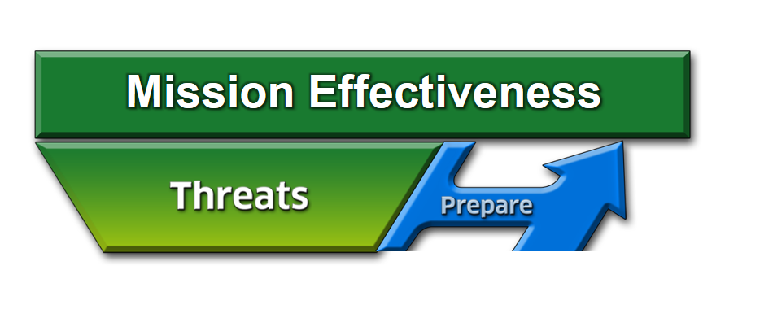
Threats
A THREAT is anything that increases operational complexity that, if not managed properly, can decrease the safety margins.

Slide 20
Threats
How do we operate in spite of the fact that we cannot eliminate the THREATS from aviation?
Effectively PREPARE for and manage them
20 of 20
Notes:
20

Slide 21
Threats
What is our strategy to manage threats?
Identify and PREPARE

Slide 22
Strategies to Prepare for Threats
Things we can use to counter threats:
ORM
Clearly defined roles of aircrew members
Complete briefing and effective communication
Limit being “heads down” at critical times
NATOPS / System Knowledge
CRM
Notes:
22

Slide 23
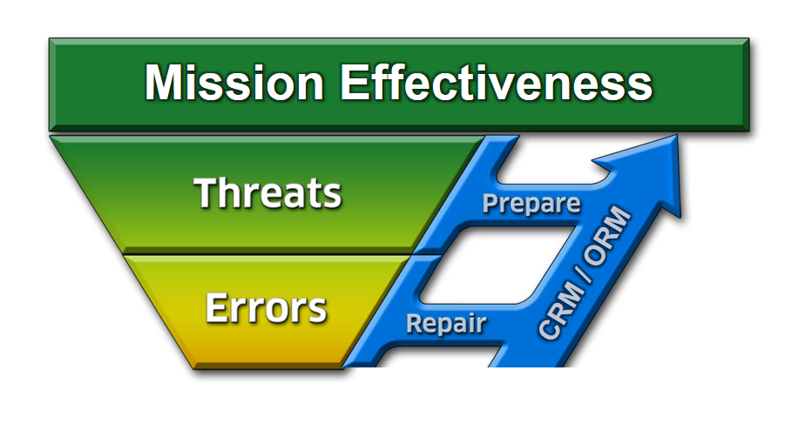
Errors
What can happen if we ignore or mismanage a THREAT?
23 of 20

Slide 24
Definition of Error
Error:
Crew action or inaction that leads to deviations from expectations and reduces safety margins
May occur from either mistakes or mismanaged threats
Error Management:
Process of correcting an error before it becomes consequential, i.e. Undesired Aircraft State and Incident/Accident
Notes:
24

Slide 25
Categories of Errors
Procedural - Following procedures but wrong execution (wrong altitude on course rules)
Communication - Missing info or misinterpretation (miscommunication with ATC)
Proficiency - Error due to a lack of knowledge/currency (night TERF/DVE landings)
Decision - Crew decision unbounded by procedures that unnecessarily increased risk (unnecessary navigation through adverse wx)
Intentional Noncompliance - Violations (AOB exceedances)
Notes:
25

Slide 26
Strategies for Errors
What is our strategy to manage errors?
CRM 7 Critical Skills
Decision Making
Assertiveness
Mission Analysis
Communication
Leadership
Adaptability / Flexibility
Situational Awareness
Identify and REPAIR
26 of 20

Slide 27
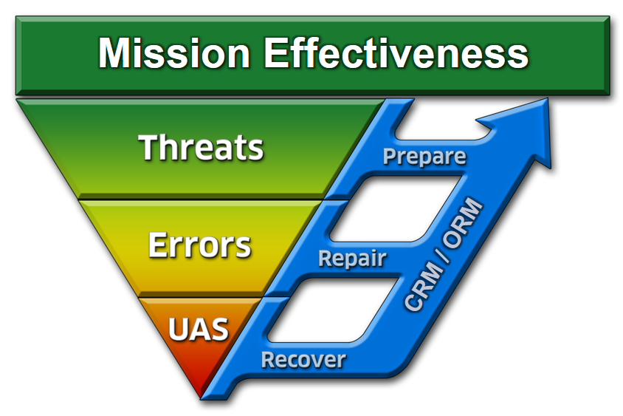
What if We Don’t Repair the Error?
Undesired Aircraft State: A position, speed, attitude, condition, or configuration of an aircraft that reduces safety margins.
27 of 20

Slide 28
How to Manage an Undesired Aircraft State
Identify and RECOVER
Notes:
28

Slide 29
Synopsis

Slide 30
Threat and Error Management
TEM is what we do. CRM is how we do it.
Notes:
MASTER TEM SLIDE

Slide 31
Focus Questions
What threats came “at” the crew and what strategies were used to prepare for threats and initially deal with them?
What errors came “from” the crew and how did they use decision making to repair the errors?
What undesired aircraft state was achieved and how did the crew recover?

Slide 32
Mission Effectiveness
MISSION EFFECTIVENESS
What is the mission?

Slide 33
Focus Question #1
What threats came “at” the crew and what strategies were used to prepare for threats and initially deal with them?

Slide 34
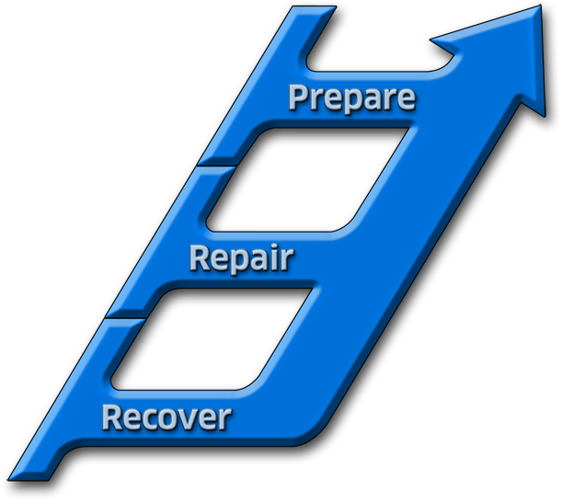
Focus Question #2
What errors came “from” the crew and how did they use DM to repair the errors?
Mission Effectiveness
CRM 7 Critical Skills
Decision Making
Assertiveness
Mission Analysis
Communication
Leadership
Adaptability / Flexibility
Situational Awareness
CRM / ORM
Identify and REPAIR
Notes:
MASTER TEM SLIDE

Slide 35
Focus Question #3
What Undesired Aircraft State was achieved and how did the crew recover?

Slide 36
Remember
Good decisions optimize risk management and minimize errors, while poor decisions can increase them
Each decision affects your future options
Poor judgment or decision making is a leading cause of failure to complete missions and of mishaps

Slide 37
Questions?

Slide 38
Mission Effectiveness
CRM 7 Critical Skills
Decision Making
Assertiveness
Mission Analysis
Communication
Leadership
Adaptability / Flexibility
Situational Awareness
CRM / ORM
Incident / Accident
Notes:
MASTER TEM SLIDE

